Slide 1

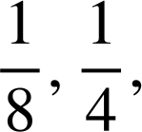
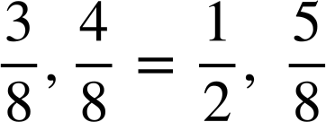
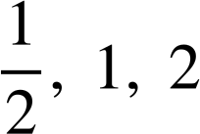

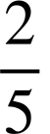
Securing understanding of sequences
Task A: Continuing sequences from a rule
For each two starting numbers: continue the sequence with a constant additive pattern, then a constant multiplicative pattern. Describe each of your sequences in words.
 | Additive pattern | Multiplicative pattern
a) Sequence | 1, 3, 5, 7, 9, … | 1, 3, 9, 27, 81 …
Description | Start on 1 then add 2 each time | Start on 1 then multiply by 3 each time
b) Sequence | 0.1, 1, 1.9, 2.8, 3.7, … | 0.1, 1, 10, 100, 1000, …
Description | Start on 0.1 then add 0.9 each time | Start on 0.1 then multiply by 10 each time
c) Sequence | −16, 8, 32, 56, 80, … | −16, 8, −4, 2, −1, …
Description | Start on (−16) then add 24 each time | Start on −16 then multiply by
d) Sequence | 0.5, 1.5, 2.5, 3.5, 4.5, … | 0.5, 1.5, 4.5, 13.5, 40.5, …
Description | Start on 0.5 then add 1 | Start on 0.5 then multiply by 3
e) Sequence | … | …
Description | Start on and add | Start on and multiply by 2
f) Sequence | 25, 10, −5, −20, −35, … | 25, 10, 4, , , … (25, 10, 4, 1.6, 0.64, …)
Description | Start on 25 then subtract 15 | Start at 25 then multiply by

Slide 2


Securing understanding of sequences
Task B: Representations of sequences
Izzy has built these patterns using blocks. Which two patterns could she combine to make a sequence which
1) Increases by 5 each time
A and D
+
=
2) Increases by 2 each time
B and D
+
=
3) Decreases by 1 each time
A and B
+
=
4) Laura and Andeep are making a repeating pattern from different shaped counters
1
2
3
4
5
6
7
8
9
10
11
12
…
What shape counter will the number 25 be?
Laura puts down the counters 144, 145 and 146, what shapes are they?
Andeep puts down three counters in a row which are all oval shapes. They are all greater than 50 but less than 60, what numbers could they be?
Laura and Andeep run out of counters when they put down the counter 178. How many of each type did they use in total
= 35 =107 =36
Square as all multiples of 5 are squares Oval, square, triangle as squares are multiples of 5 so 145 must be square 52, 53, 54 or 57, 58, 59.
Mathematics in Education and Industry
v2.2

